Slide 1
Projection
Introduction

Slide 2
Projection
Is a type of Transformation
Transforming points in a coordinate of dimension n into a coordinate system of dimension m where m < n
Planar Geometric Projection: Projecting an object on to a flat plane
Turning 3D shapes to its 2D plane (this chapter)
From 2D to 1D also possible

Slide 3
Projection (Terminologies)
Object/Target Point (P): A single point on an object/geometry we're trying to project (calculate projection of)
Projected Point (P'): The projected point after a projection transformation is applied for a given point P'. Projected points together constitutes the projected image
Projectors: The "rays" responsible for projection. They'll intersect the projection plane.
Projection Plane (PP): The plane where the projected image of the object will appear on. This plane holds all of the P' points. Also known as view plane.
Center Of Projection (COP): The singular point where all the projectors/projection rays converge (only applicable to perspective projection).
Direction Of Projection (DOP): The direction towards which the parallel projection rays go towards (only applicable to parallel projection).

Slide 4
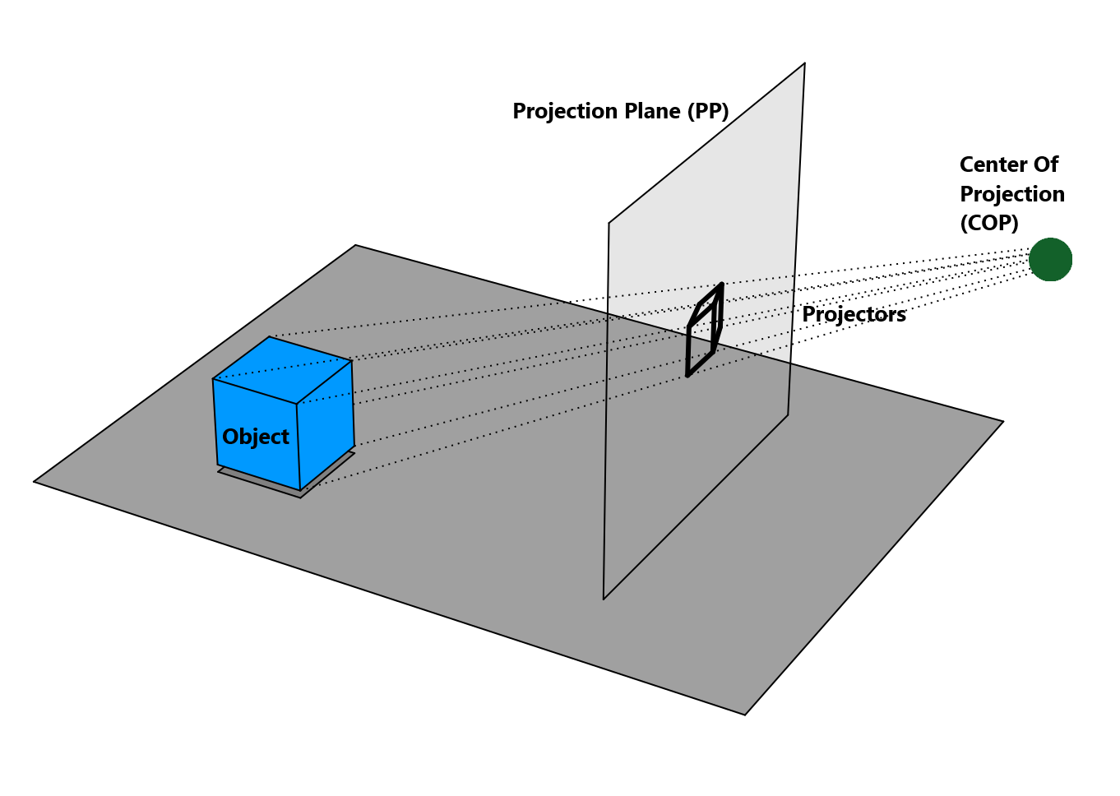
Projection (Anatomy)

Slide 5
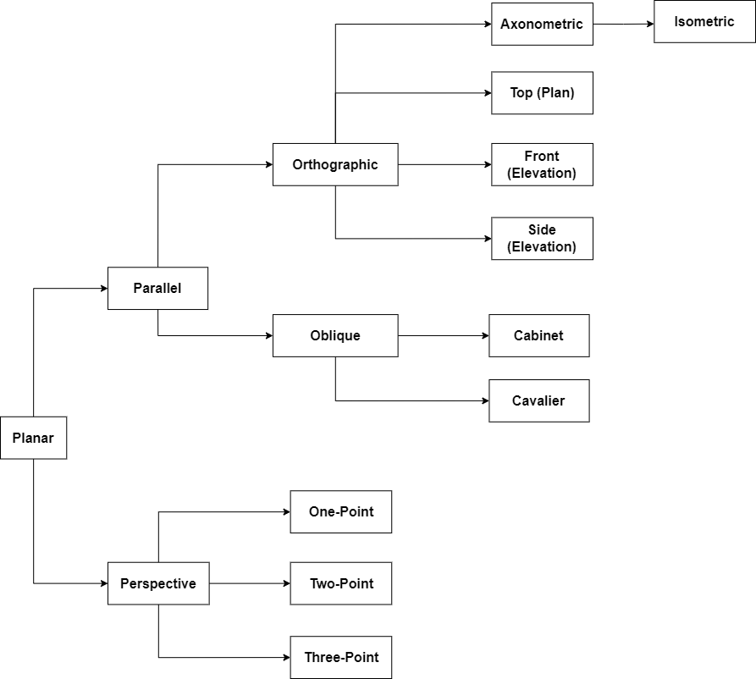
Projection
(Types)

Slide 6
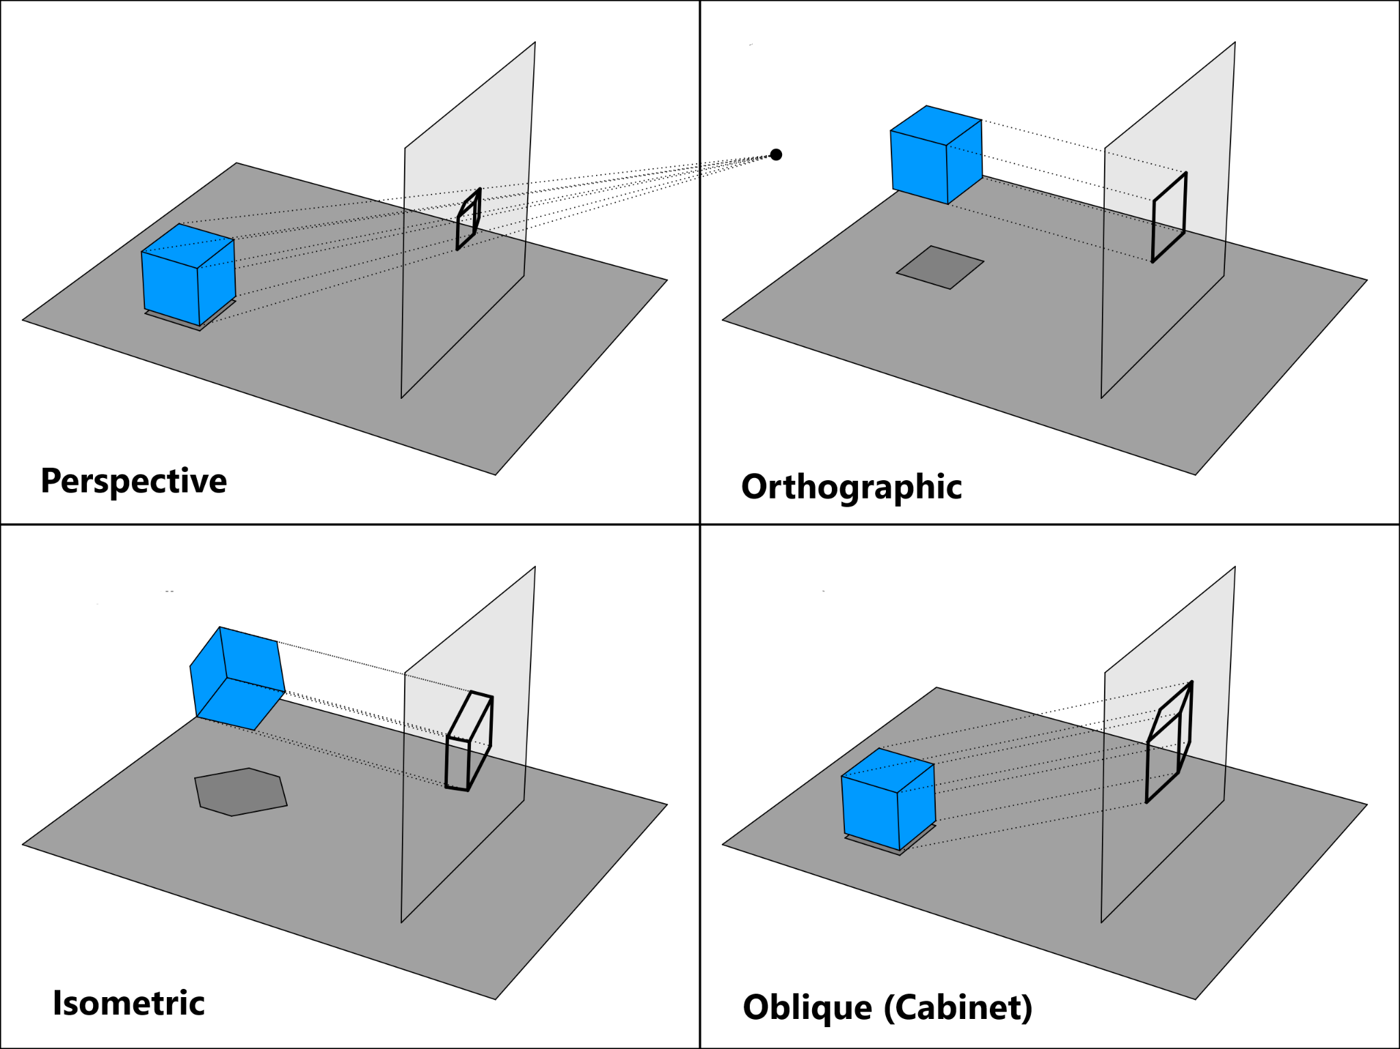

Slide 7
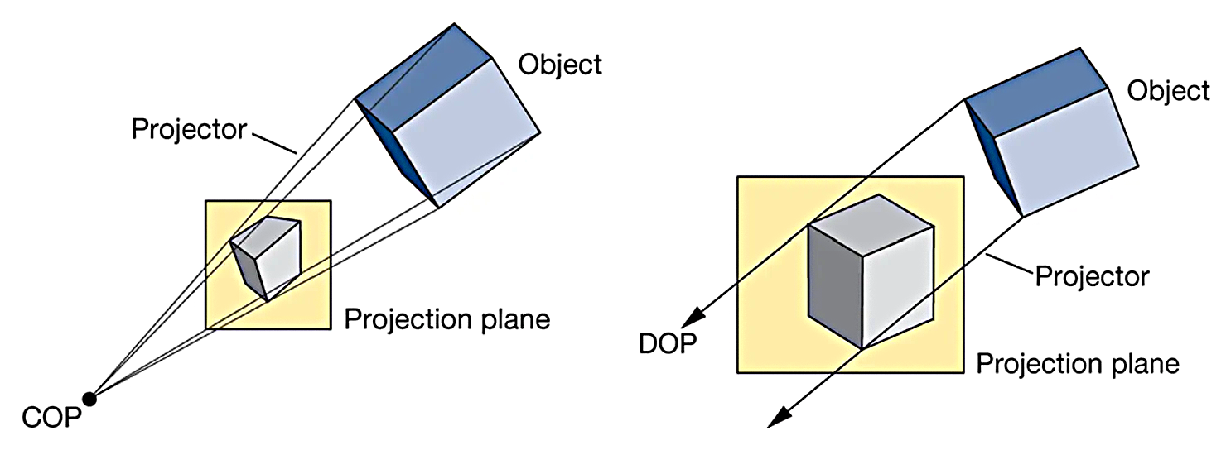
Perspective
vs
Parallel
 | Perspective | Parallel
Nature of Projectors | Projectors aren't parallel, and will converge at a point called COP. | The projectors are always parallel, will never converge.
Configured By | The Center of Projection (COP) and the distance between COP and the projection plane (PP) | The angles those eventually control the Direction of Projection (DOP)
Foreshortening | Yes, so more familiar to human eye | No, appears less realistic
Examples | Cabinet, Cavalier, Orthographic | 1-point, 2-point, 3-point

Slide 8
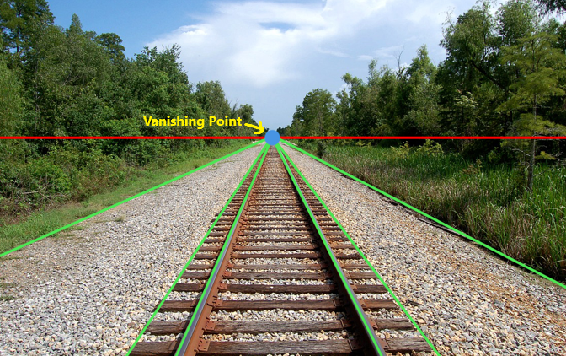
Perspective Projection

Slide 9
Perspective Projection (Attributes)
Vanishing Point: All lines that are parallel to each other (in 3D space)
appear to converge into a single point (in projected space)
One-point Perspective Projection: 1 vanishing point
Two-point Perspective Projection: 2 vanishing points
Three-point Perspective Projection: 3 vanishing points
In reality, there are infinite number of vanishing points.
Foreshortening: Basically the phenomenon of far-away objects appearing smaller than the closer ones (despite having equal size).
More realistic since resembles human vision. Used in video games, animation, VR

Slide 10
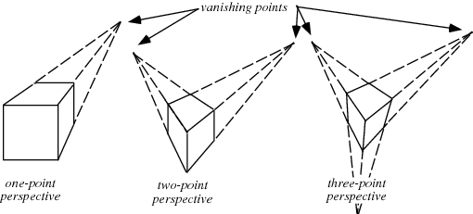
Perspective Projection (Types)

Slide 11
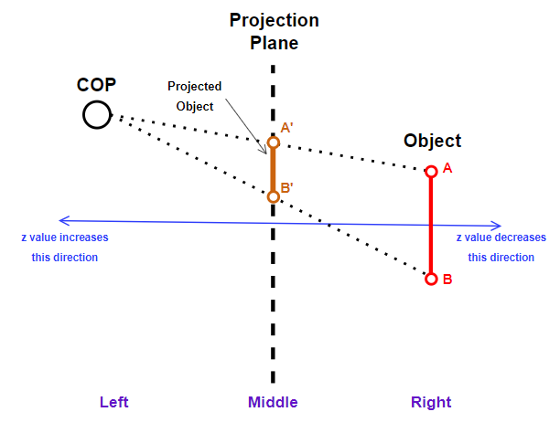
Perspective Projection (Geometric Setup)

Slide 12
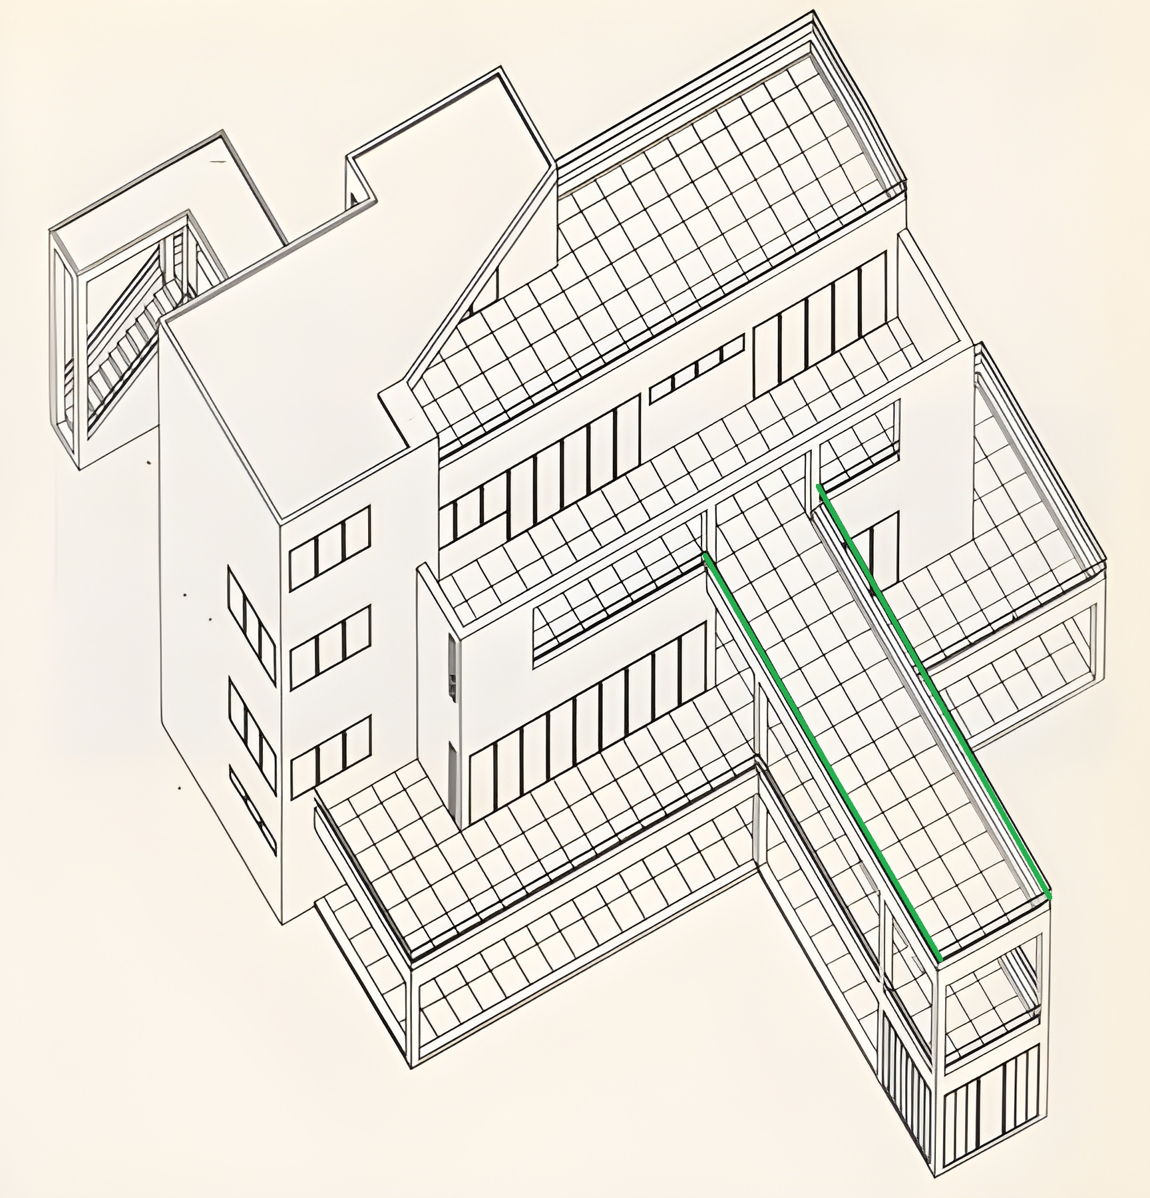
Parallel
Projection

Slide 13
Parallel Projection (Attributes)
Parallel Lines: Lines that are parallel to each other (in 3D space) even still appear parallel to each other (in projected space)
No Convergence: Since the lines remain parallel there are no single point the projectors converge into (in other words, they converge at infinity). So there are no COP, but there is a Direction Of Projection (DOP).
No Foreshortening: Objects that are far-away appear the same size as the closer ones.
For Orthographic the DOP is equal to the normal vector of the plane, whereas they are not equal in case of Oblique.
Parallel Projected Images are less realistic, but they are good for architectural planning and design.
(Some video games use isometric projection which is a type of parallel projection)

Slide 14
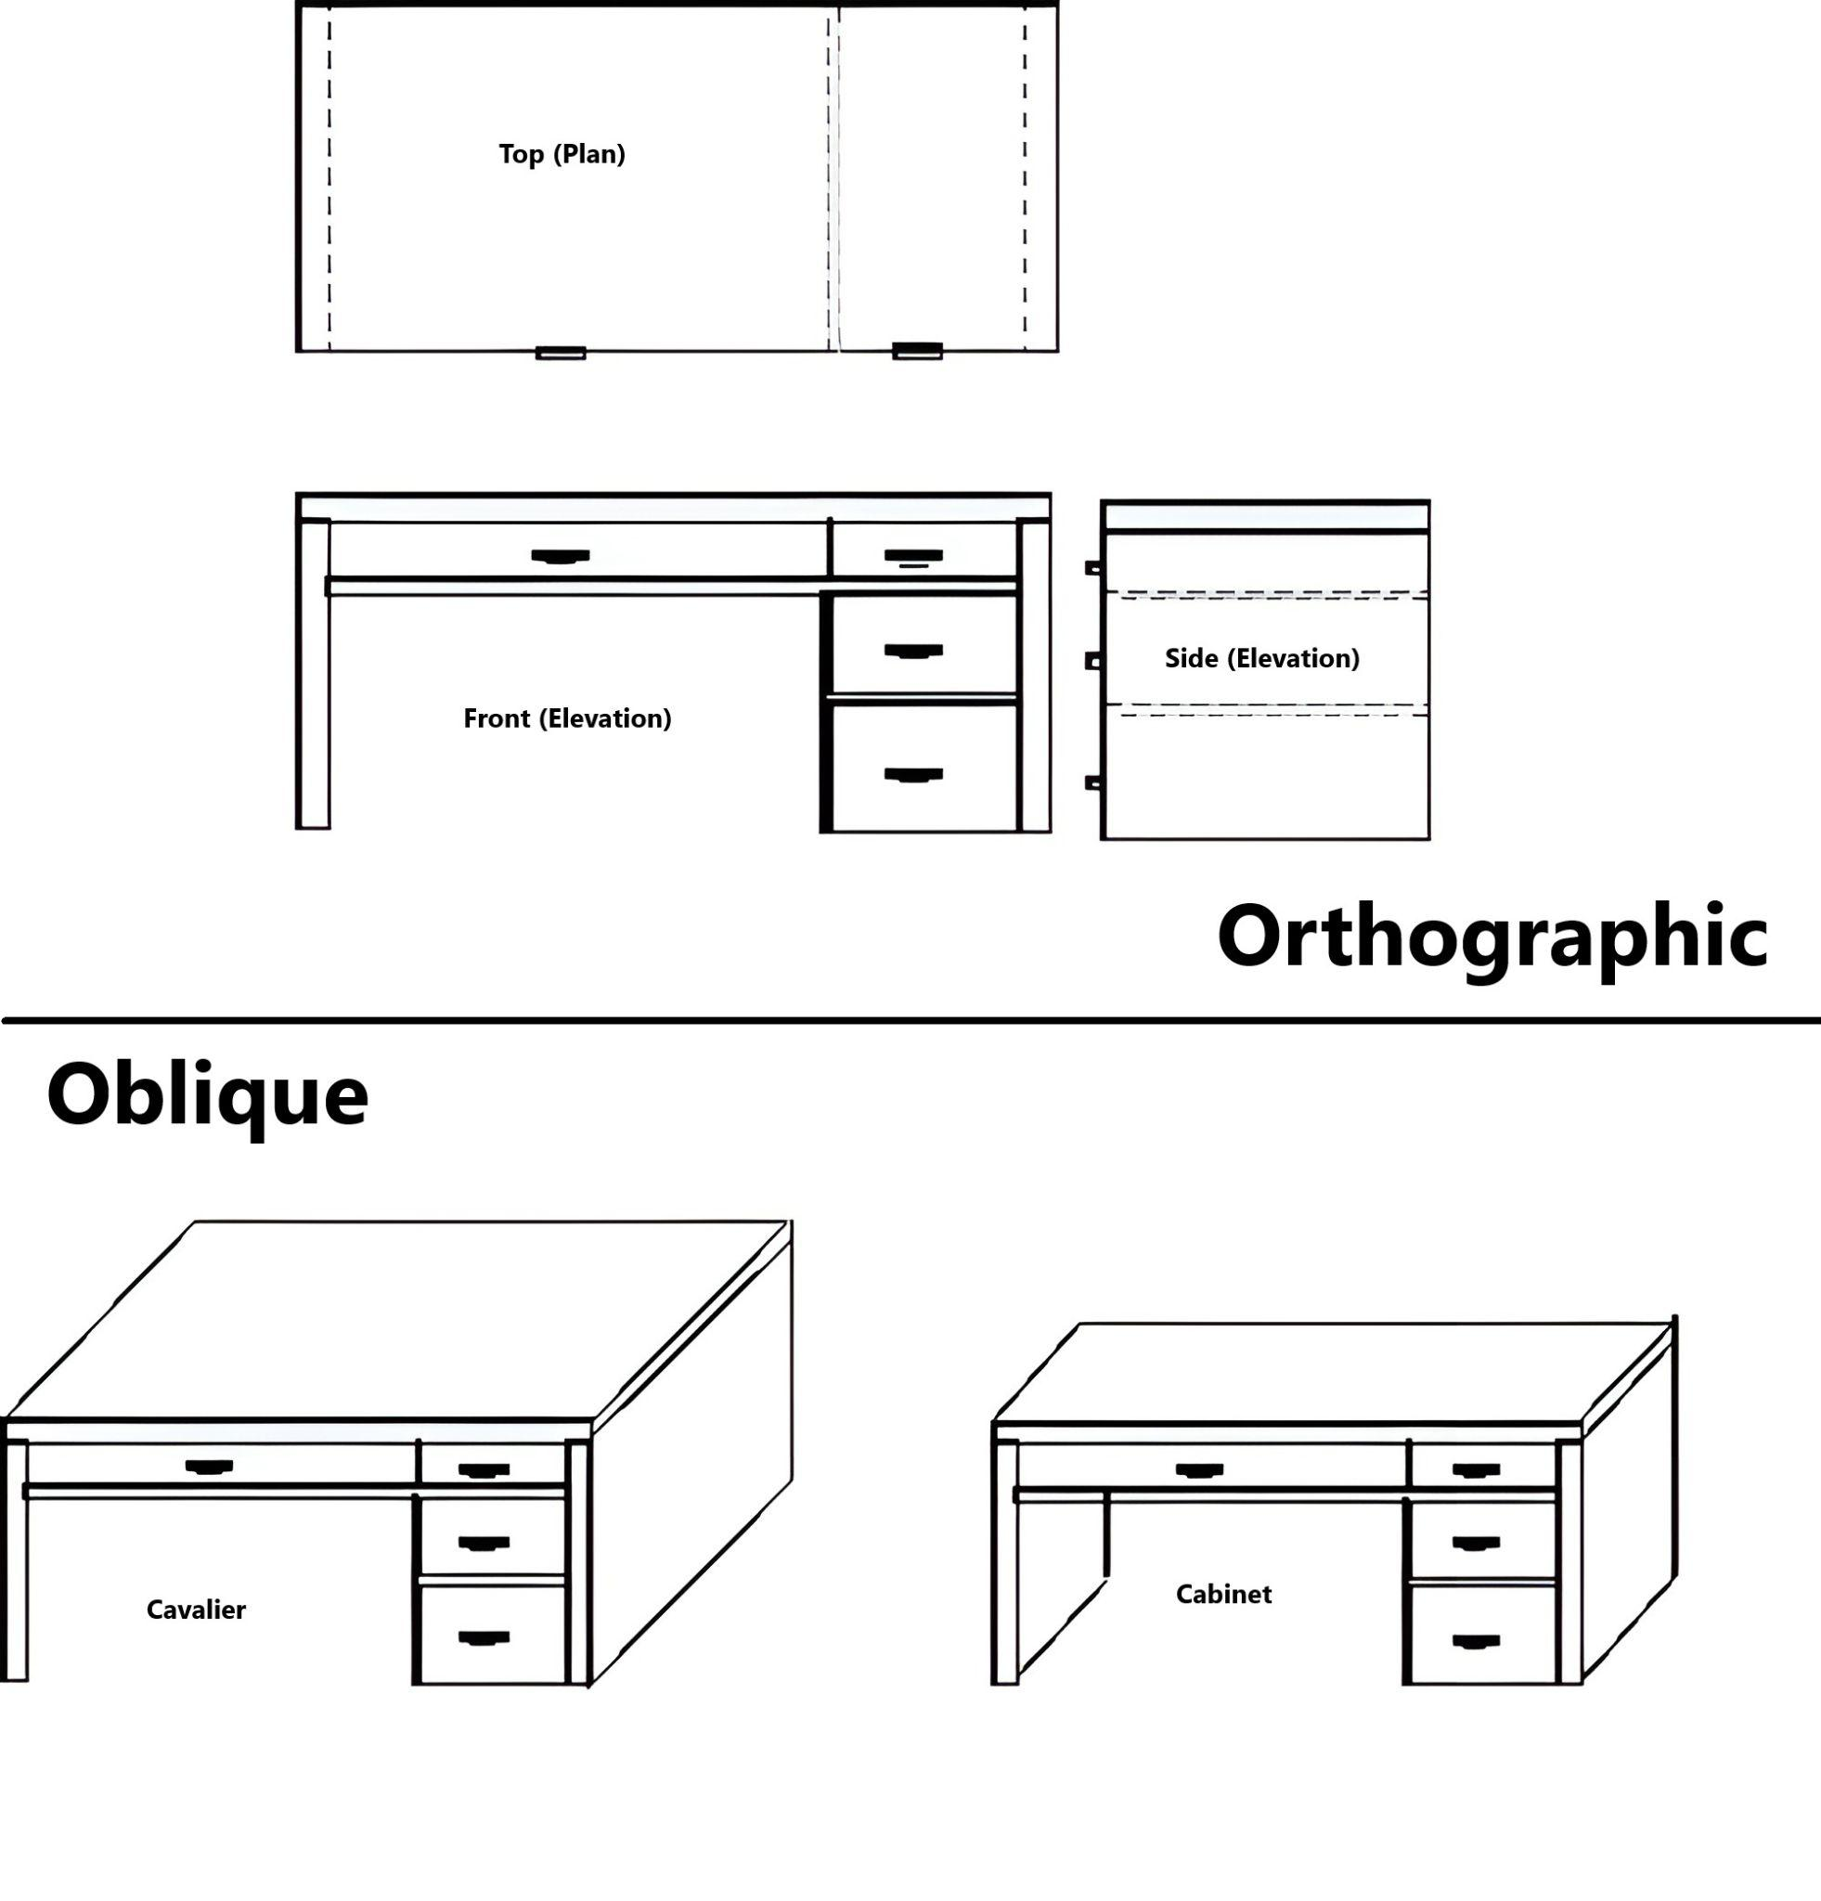
Parallel
Projection
(Types)

Slide 15
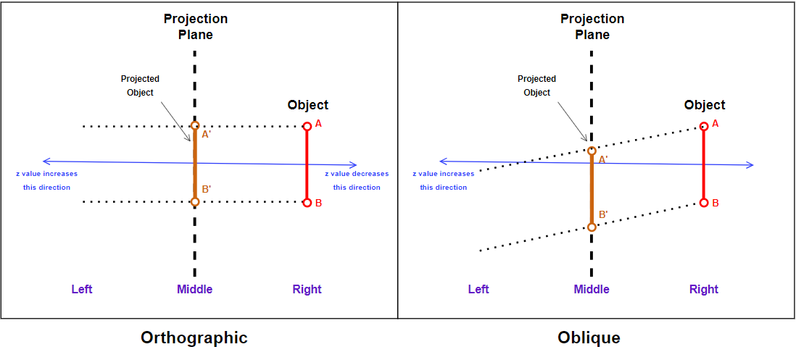
Parallel Projection (Geometric Setup)

Slide 16
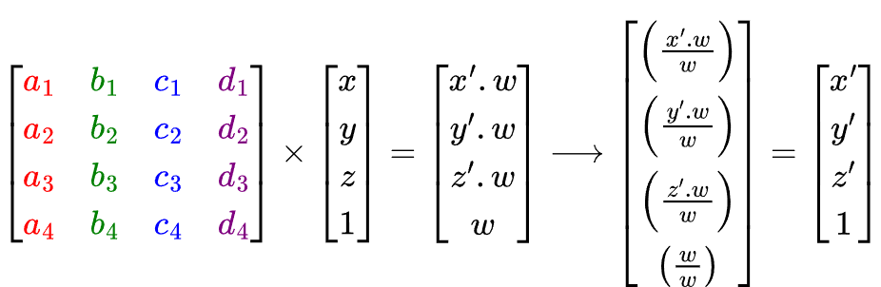
Performing Projection Math
Depending on the scenario, we need to use a specific projection matrix. A 4x4 homogeneous coordinate matrix since we're in 3D.
The point to be projected P(x,y,z) will need to be converted into a 4x1 column-matrix, the w/last value will be 1.
Multiplying the projection matrix and the point column-matrix will give a 4x1 result containing the transformation point.
The w/last value of result won't necessarily be 1. In this case, we need to divide all values in the result by w to get the actual result called P'(x',y',z').

Slide 17
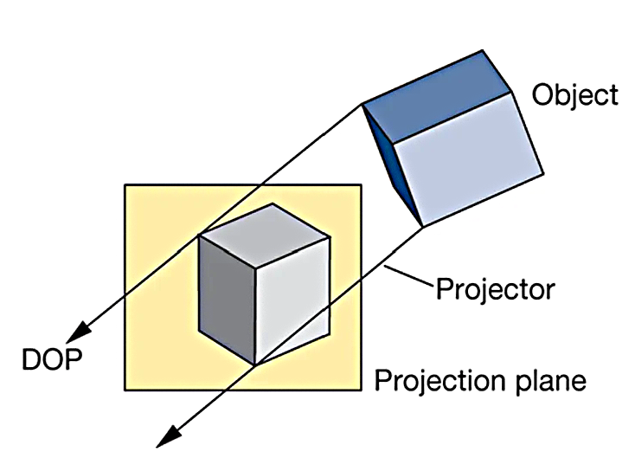
Deriving Parallel Projection Matrix
The projection rays don't converge, so there are no Center Of Projection (COP)
There is however, a Direction Of Projection (DOP)
This DOP is steered by some angles/scaling factors, which control the ultimate projection transformation
Different angle/scaling factor configuration for Cabinet, Cavalier, Orthographic

Slide 18
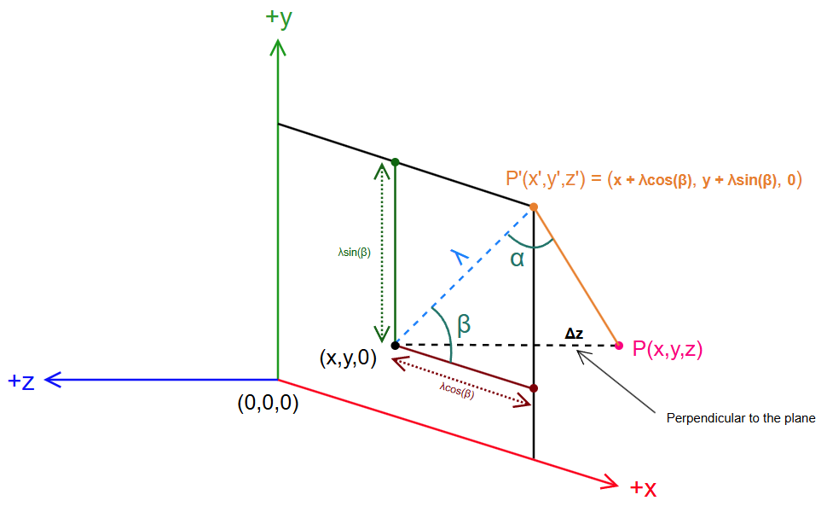
P' is the projected point on plane for P
The distance between the plane and P is Δz
(x, y, 0) is an equivalent point for P(x, y, z) put on the projection plane
β is inclination angle
x' = x + λ cos(β) ….1(a)
y' = y + λ sin(β) …..1(b)

Slide 19
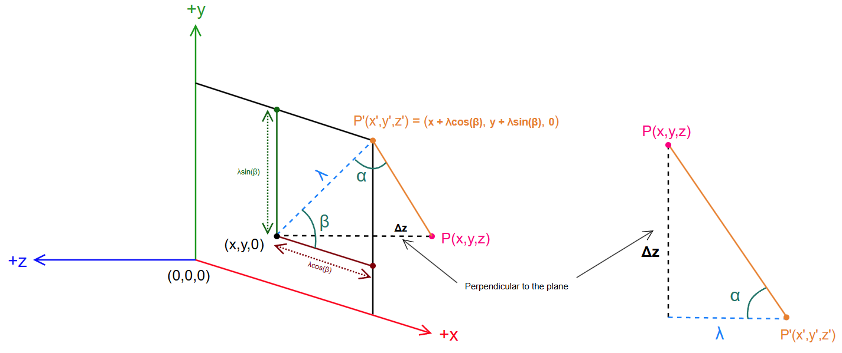
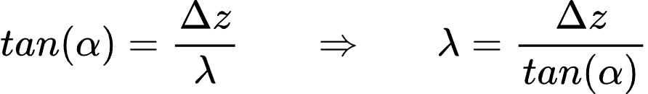
α is the angle between the projection plane and projection ray, this is the angle of skewness.
We will address Δz as just z since:
Δz = (z - 0) = z

Slide 20
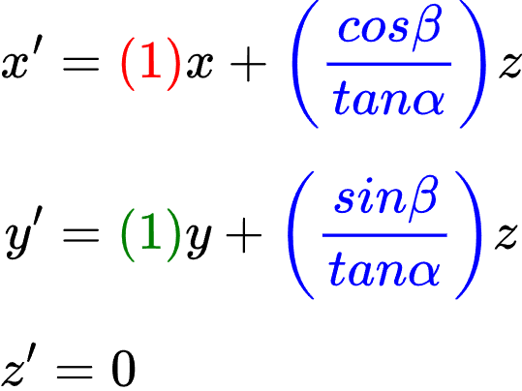
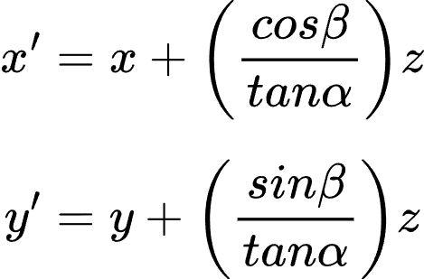

From equations 1(a) and 1(b), we can write
Rewriting with color coded coefficients
Since on the projection plane, all z values are 0 (for this particular scenario)
Coefficients Color Coding:
(x = red, y = green, z = blue, leftover = purple)

Slide 21
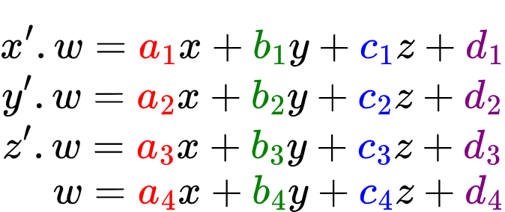
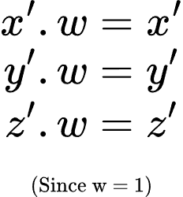
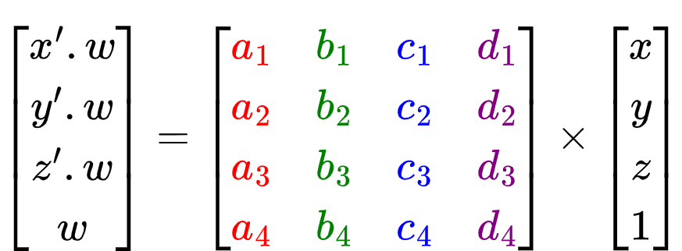
Strategy: Converting x', y', z' equations to a 4x4 matrix
We don't have any w equation.
We will consider w = 1
(since parallel projection)

Slide 22
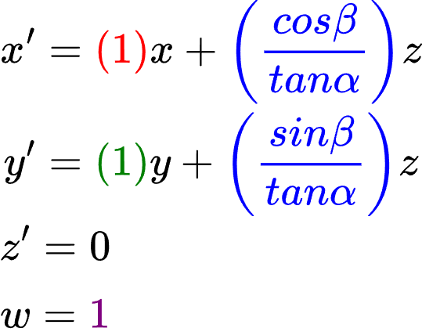
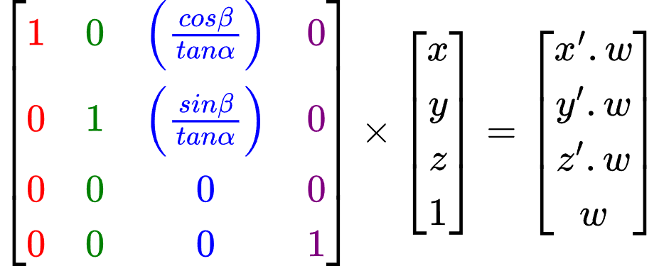
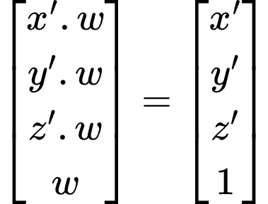
Since, w = 1 (only for this scenario)

Slide 23
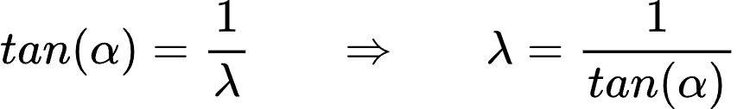
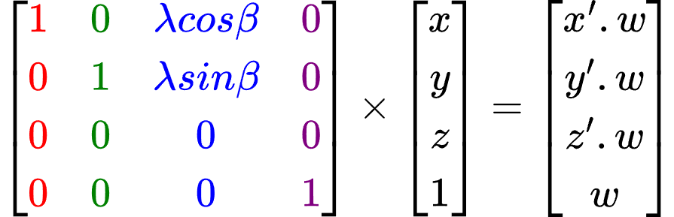
Considering Δz = z as 1, we can get this relation:
For the math,
We can either build the matrix using
(α, β) or (λ, β)
By which, we can get an alternate matrix:

Slide 24
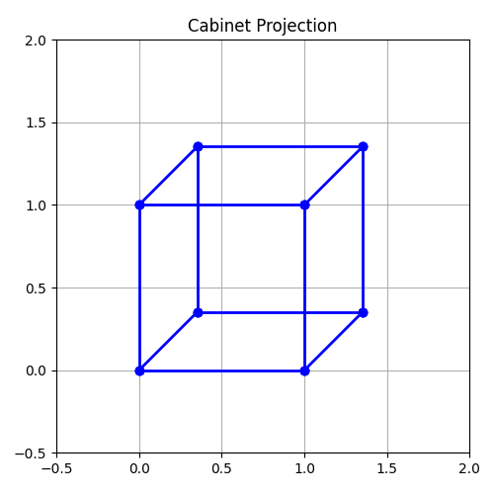
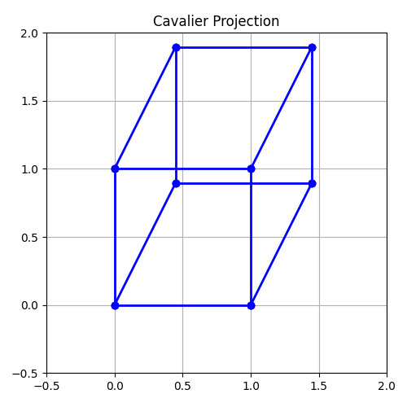
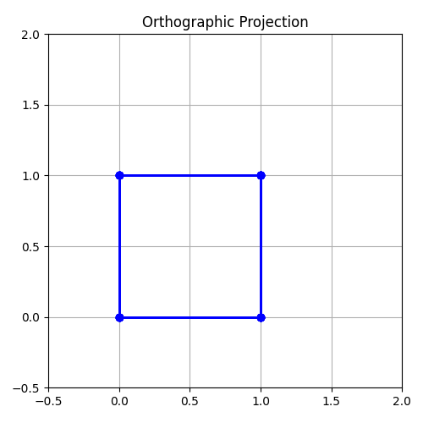
Configurations for different types of parallel projections
Type | Oblique? | λ | α (deg) | β (deg) | Preview
Cabinet | Yes | 0.5 | 63.4 | 0-360
Cavalier | Yes | 1 | 45 | 0-360
Orthographic | No | 0 | 90 | 0-360

Slide 25
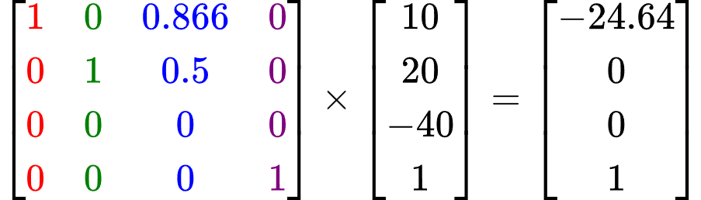
Example: For a point P (10, 20, -40), calculate the projected point P' using Cavalier Projection, orientation angle is 30°
For Cavalier, α = 45°. And it is given that, β = 30°
The whole calculated matrix with the point multiplied is:
We don't need to divide values by w since w is already 1
P' is (-24.64, 0, 0)

Slide 26
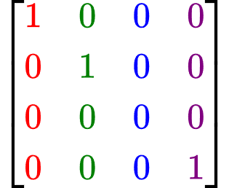
Example: Derive the matrix for orthographic projection
Here, the projection rays will be perpendicular to the projection plane, α will be 90 degrees, making λ as 0, so the value of β won't even be considered.
Butting these values into the formula matrix gives:

Slide 27
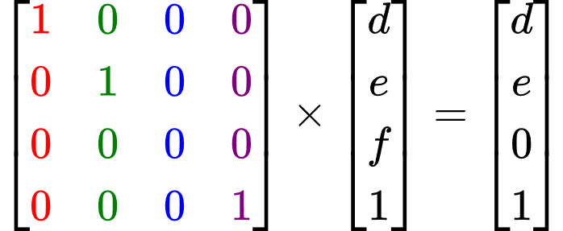
Example: Calculate Orthographic Projection for the point P (d, e, f)
We don't need to know any other value since the orthographic projection matrix is constant, we simply multiply our provided point P (as a homogenous column-matrix) with the matrix.
In fact, applying orthographic projection to a point is equivalent to copying the point's x and y values, while setting its z value to 0. [(x, y, z) becomes (x, y, 0)]

